Slide 1
Excel Connections

Slide 2
What is Excel Connection?
The first type links to data in another workbook, the external connection in Excel can link to another file type or database.
Why use Excel connection?
External connections in Excel can ‌link to Microsoft servers, such as SQL and Access Databases, or any other server where you store data.
Using the Get External Data and Connections features, you can create and manage connections easily.

Slide 3
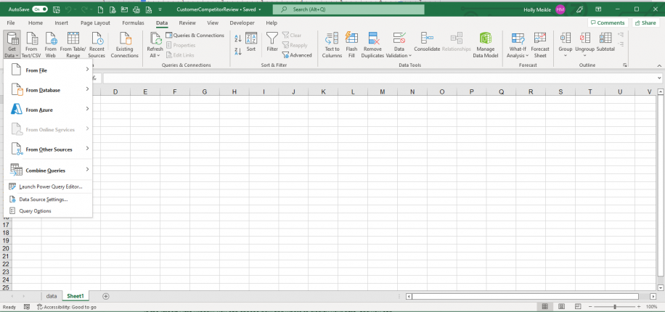
Create Data Connection in Excel
Open an Excel workbook and go to Data tab.
Click on Get Data.

Slide 4
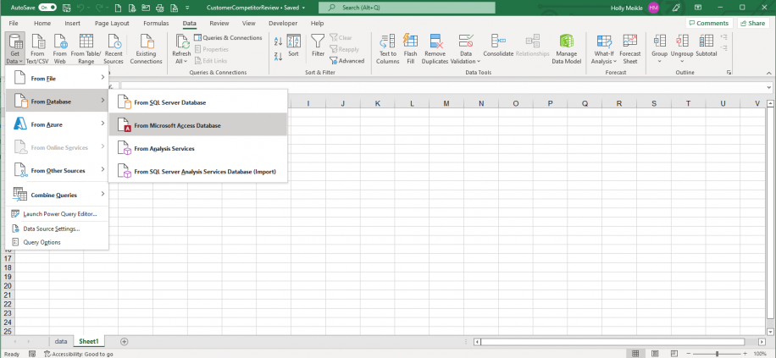
Create Data Connection in Excel (Cntd…)
From the drop-down menu, select the source you would like to connect to.

Slide 5
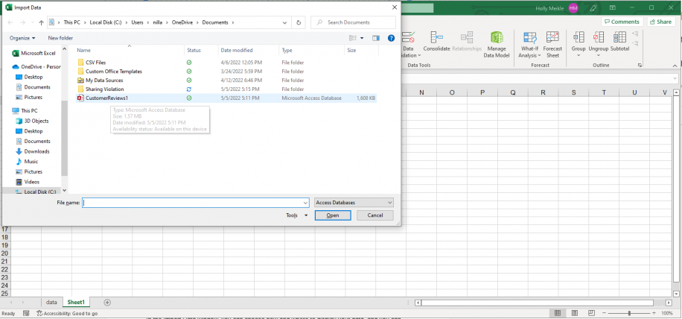
Create Data Connection in Excel (Cntd…)
From the “Import Data” dialog box, select the Access file to import.
Click “Open” to begin the import process.

Slide 6
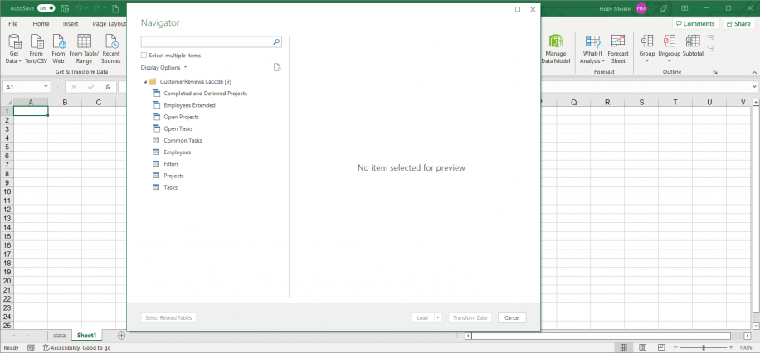
Create Data Connection in Excel (Cntd…)
Excel launches the “Navigator” pane, so you can select the table to import from the database. Click on the desired data table on the left-side list to preview.

Slide 7
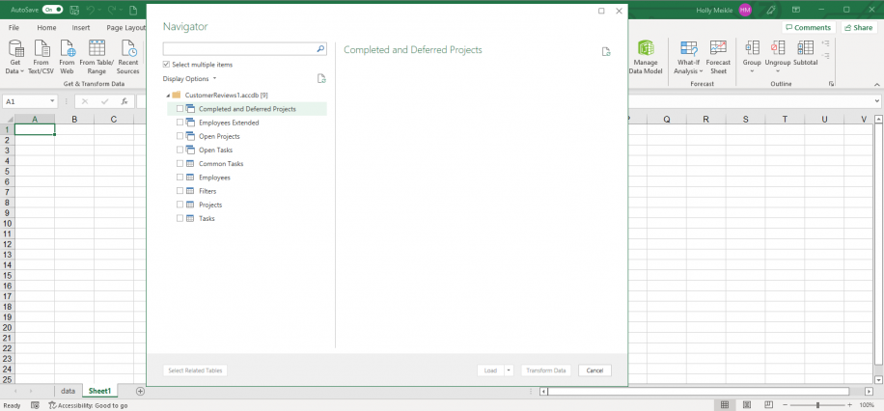
Create Data Connection in Excel (Cntd…)
In case you would like to preview more than one table, tick the “Select multiple items” right below the search bar.

Slide 8
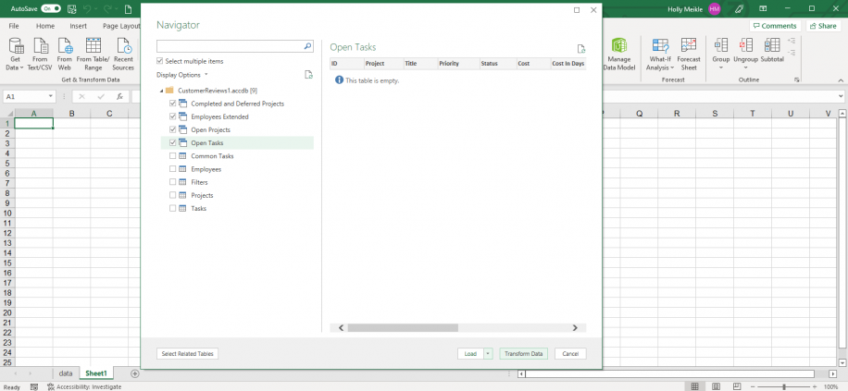
Create Data Connection in Excel (Cntd…)
At this point, you can “Load” to import the data, or you can make any changes if needed.
Select “Transform Data” to make changes.

Slide 9
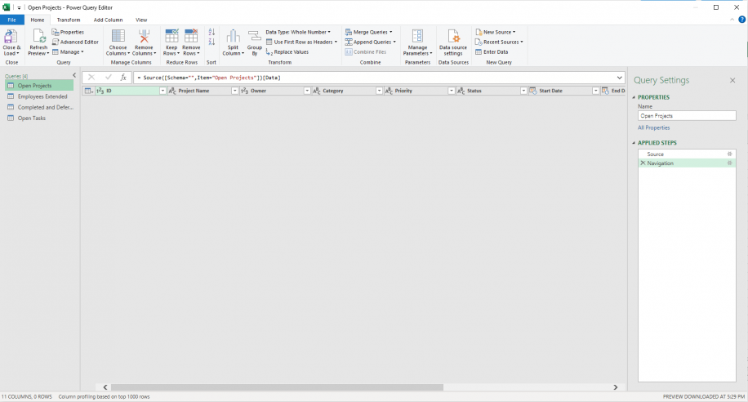
Create Data Connection in Excel (Cntd…)
Excel automatically launches the Power Query Editor, which can help you automate future loading and transformation of data.

Slide 10
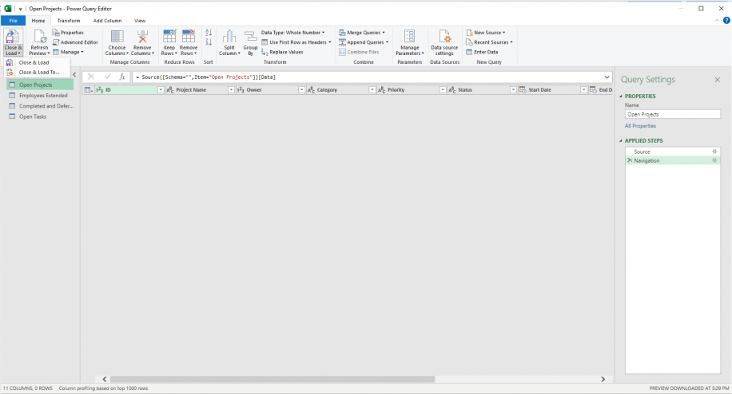
Create Data Connection in Excel (Cntd…)
Once you finish making the changes, click “Close & Load” to continue setting up your connection.

Slide 11
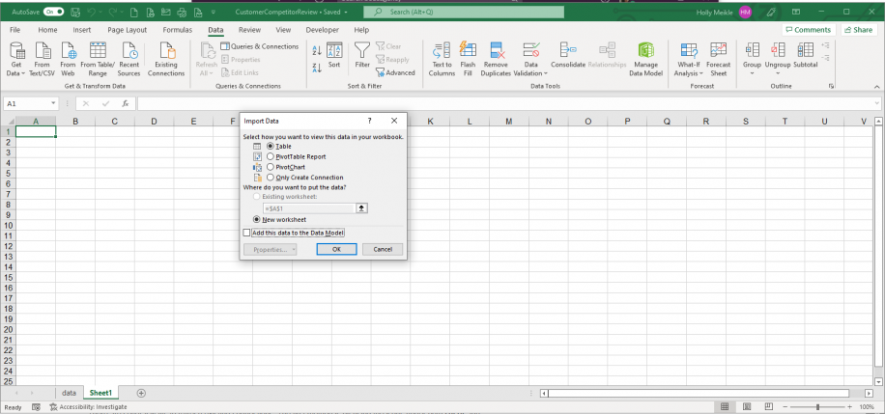
Create Data Connection in Excel (Cntd…)
In the “Import Data” box. The first four options will allow you to view the data in your workbook as a “Table”, “PivotTable Report”, “PivotChart”, or “Only Create Connection”. The following two options relate to where the data will be imported, the “Existing worksheet” or a “New worksheet”, set by default.

Slide 12
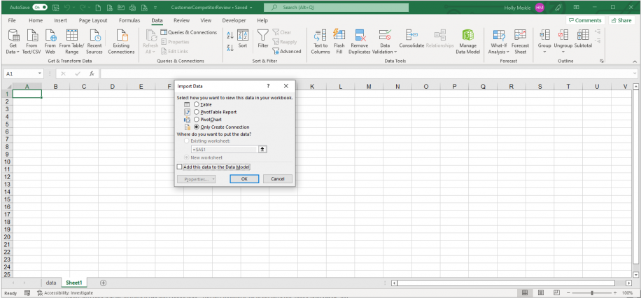
Create Data Connection in Excel (Cntd…)
If you select “Only Create Connection”, you establish the connection to the Access Database without displaying the data in your workbook. Click “OK” to finish.

Slide 13
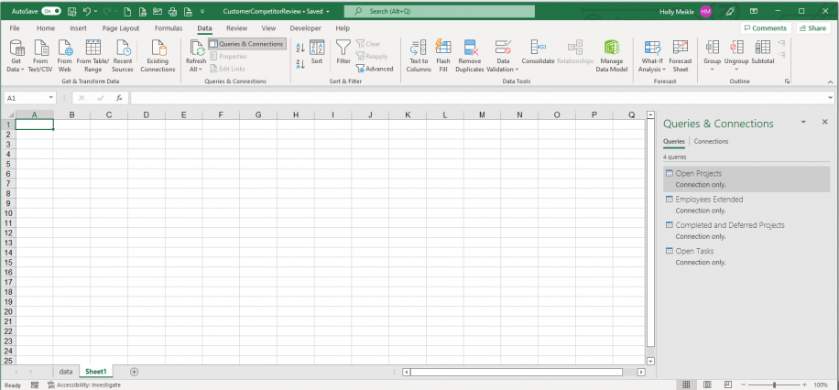
Create Data Connection in Excel (Cntd…)
You should now be able to see the “Queries and Connections” right-side pane, which provides a breakdown of your newly created external data connection

Slide 14
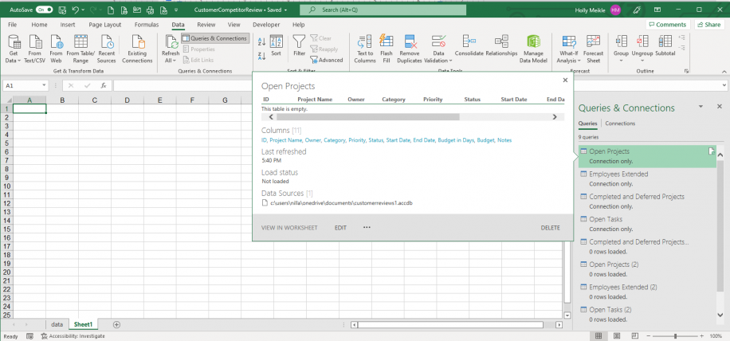
Change Data Source
Open the Excel workbook that contains the external connection. Go to Data
Queries & Connections. Double-click on any of the queries listed to the right in the “Queries & Connections” pane.

Slide 15
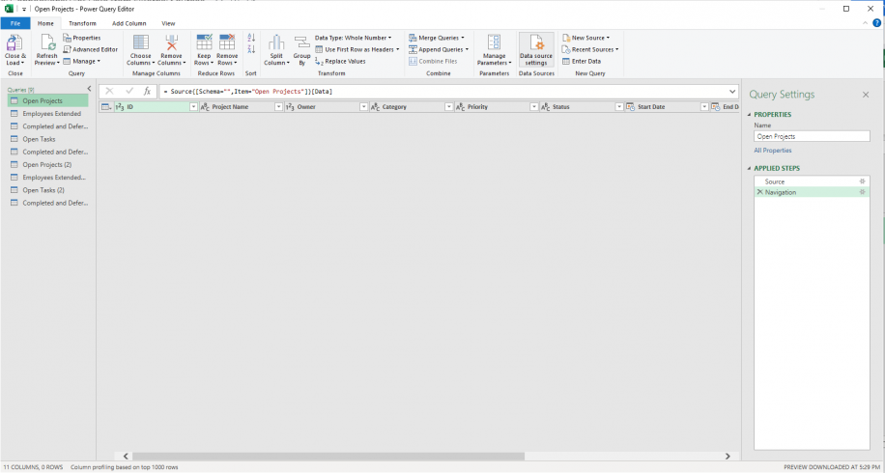
Change Data Source (Cntd…)
In the “Power Query Editor”, click on the “Data source settings” button to the right.

Slide 16
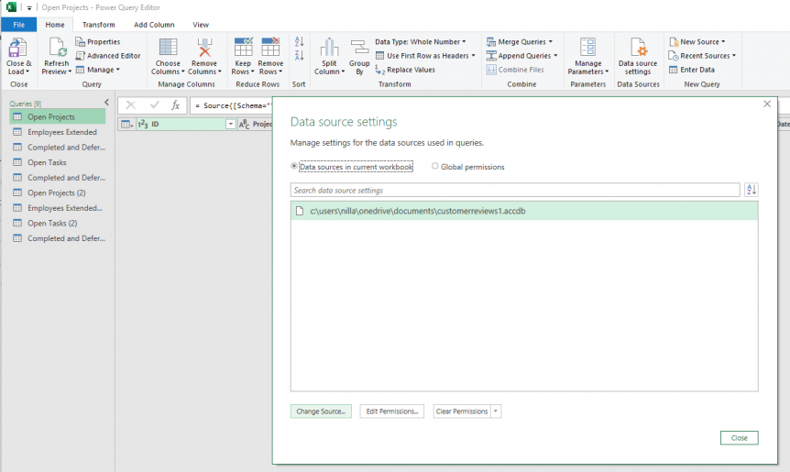
Change Data Source (Cntd…)
Click on the data source file path and then press the “Change Source…” button, right below.

Slide 17
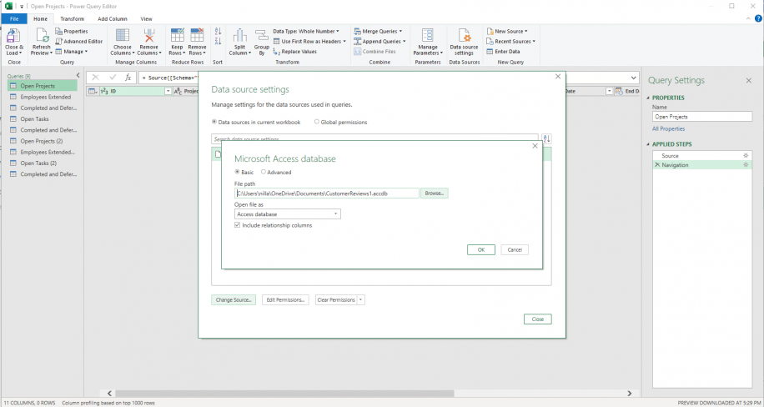
Change Data Source (Cntd…)
Click “Browse” to launch “File Explorer”.

Slide 18
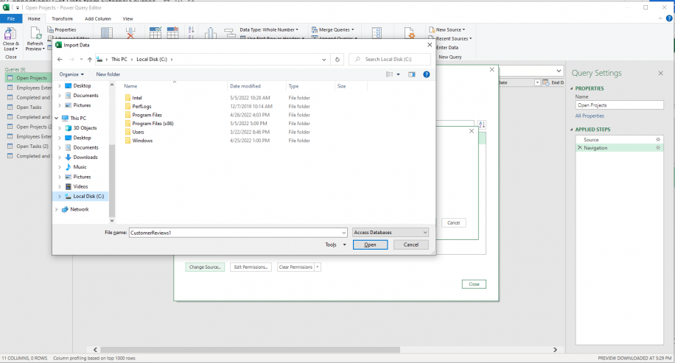
Change Data Source (Cntd…)
Choose the new data source and click “Open” to finish.

Slide 19
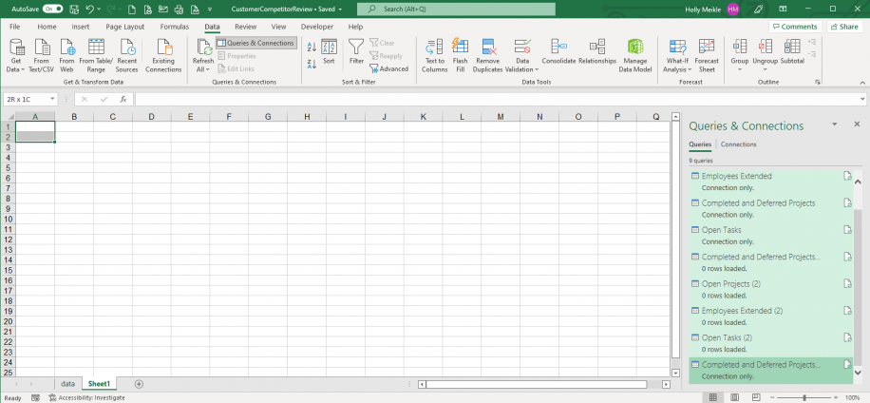
Delete Data Source
Go to Data
Go to Queries & Connections. Double-click on any connection to remove it, or press Shift + Down Arrow to select multiple queries.

Slide 20
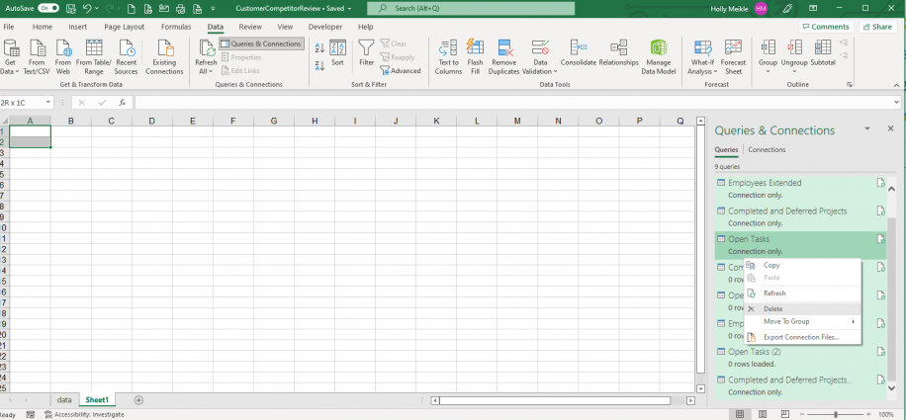
Delete Data Source (Cntd…)
Right-click on the selected queries and click on “Delete”.

Slide 21
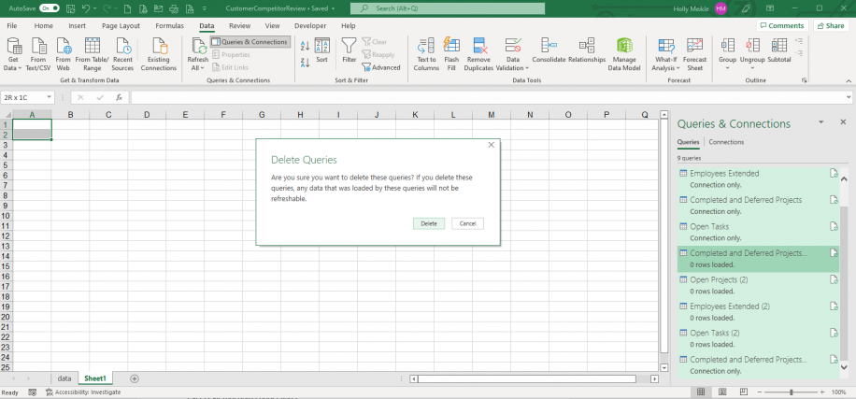
Delete Data Source (Cntd…)
Click on “Delete” to confirm that you want to remove the selected queries.

Slide 22
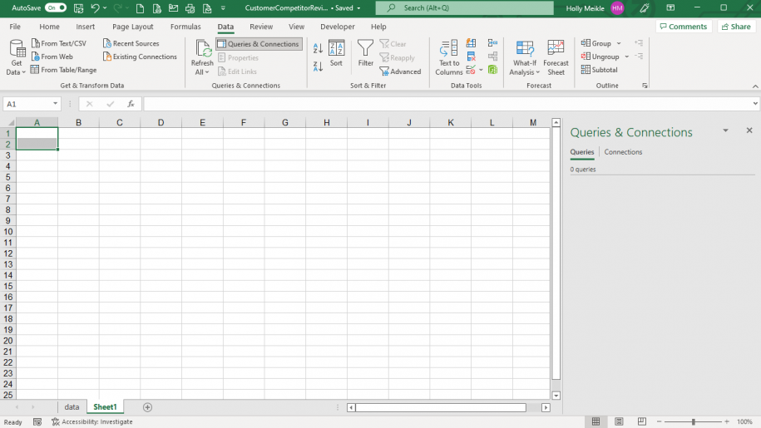
Delete Data Source (Cntd…)
The “Queries & Connections” pane should now appear empty.

Slide 23
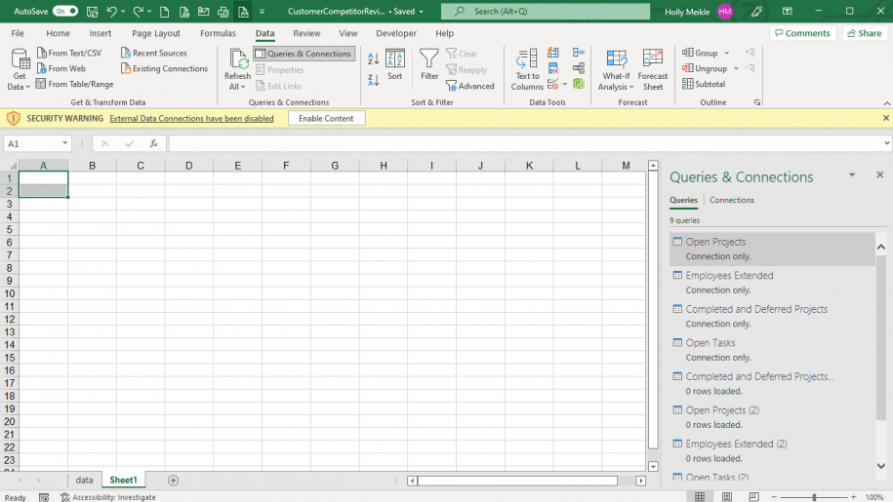
Delete Data Source (Cntd…)
To reverse this process quickly, press Ctrl + Z as many times as needed to reestablish all connections. This might prompt Excel to warn you with the following security warning message “External data connections have been disabled”. Click on “Enable Content” to enable the external connections once again.

Slide 24
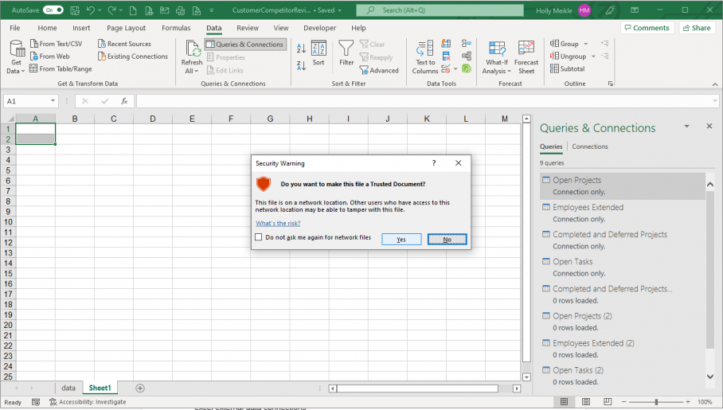
Delete Data Source (Cntd…)
Click “Yes” to make the file a trusted document.

Slide 25
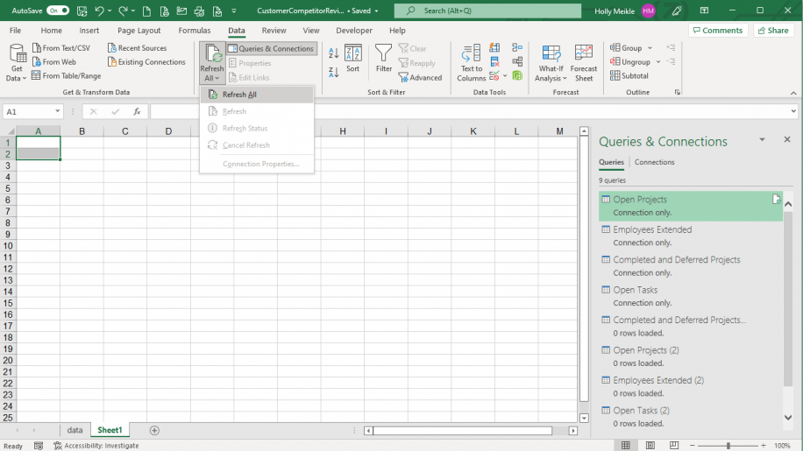
Refresh Data Source
Go to Data
Go to Refresh All.

Slide 26
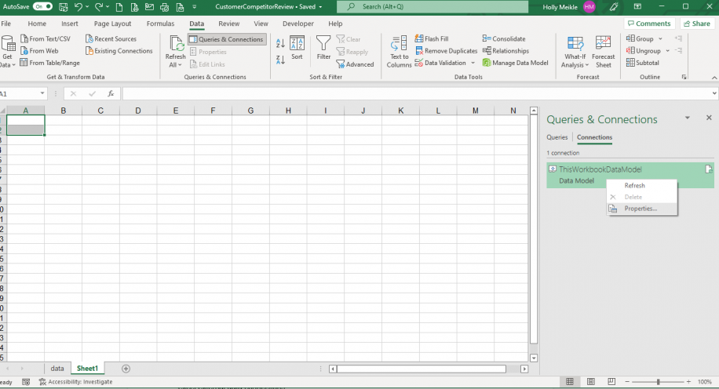
Refresh Data Source Automatically
In the “Queries & Connections” pane, select the “Connections” tab. Right-click on the connection and select “Properties”.

Slide 27
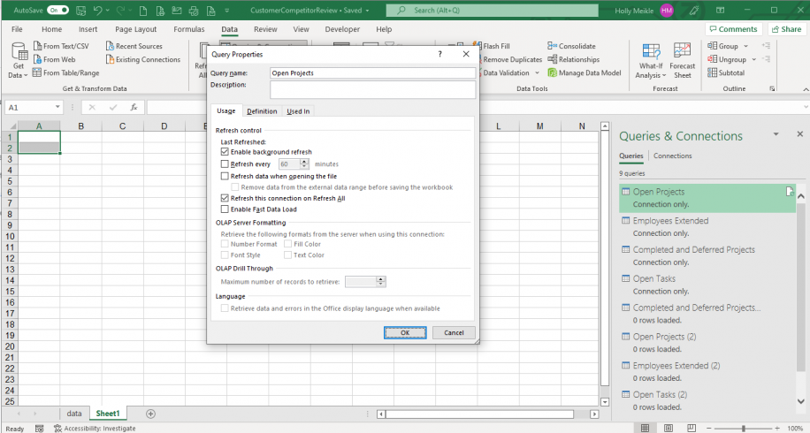
Refresh Data Source Automatically (Cntd…)
In the “Query Properties” window, the “Enable background refresh” should be enabled by default if the connection type is an “Only Create Connection”. This makes it possible for the system to carry on working without having to wait for the query to refresh.

Slide 28
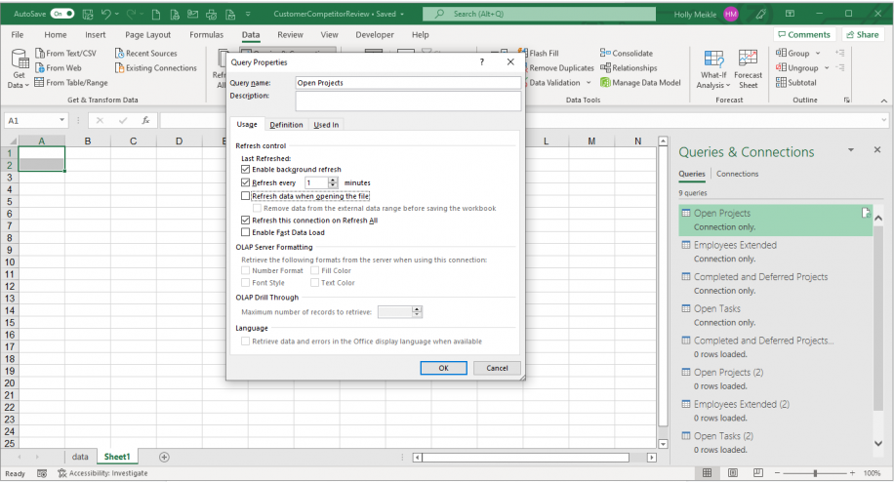
Refresh Data Source Automatically (Cntd…)
Enable the “Refresh every” option to set the frequency of data updates. You can set it as low as 1 minute. As you have also enabled background refresh, it shouldn’t slow down the functioning of Excel. Click “OK” to finish.

Slide 29
Tasks
Download any file from here (http://www.databasedev.co.uk/downloads.html) and import it into excel using excel connection.
Download another file, change the data source of you existing worksheet.
Set the automatic refresh mode in your data source.
Find out how can you import an SQL database.

Slide 30
THANKS

